Slide 1
NLP

Slide 2
Text Similarity
Thesaurus-based Word Similarity Methods

Slide 3
Quiz
Which pair of words exhibits the greatest similarity?
1. Deer-elk
2. Deer-horse
3. Deer-mouse
4. Deer-roof

Slide 4
Quiz Answer
Which pair of words exhibits the greatest similarity?
1. Deer-elk
2. Deer-horse
3. Deer-mouse
4. Deer-roof
Why?

Slide 5
Remember Wordnet
ungulate
even-toed ungulate
odd-toed ungulate
ruminant
equine
okapi
deer
giraffe
mule
horse
zebra
elk
wapiti
caribou
pony

Slide 6
Path Similarity
Version 1
Sim (v,w) = - pathlength (v,w)
Version 2
Sim (v,w) = - log pathlength (v,w)
Notes:
J&M - remove

Slide 7
Problems with this Approach
There may be no tree for the specific domain or language
A specific word (e.g., a term or a proper noun) may not be in any tree
IS-A (hypernym) edges are not all equally apart in similarity space

Slide 8
Path similarity between two words
Version 3 (Philip Resnik)
Sim (v,w) = - log P(LCS(v,w))
where LCS = lowest common subsumer, e.g.,
ungulate for deer and horse
deer for deer and elk
Notes:
J&M - remove

Slide 9
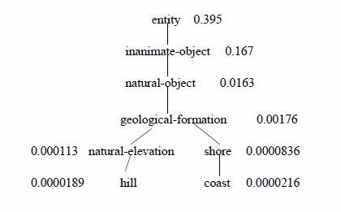

Information content
Version 4 (Dekang Lin)
Wordnet augmented with probabilities (Lin 1998)
IC(c) = -log P(c)
Sim (v,w) = 2 x log P(LCS(v,w)) / (log P(v) + log P(w))
= 0.59
Notes:
J&M - remove

Slide 10
Wordnet Similarity in NLTK
NLTK
>>> dog.lin_similarity(cat, brown_ic)
0.879
>>> dog.lin_similarity(elephant, brown_ic)
0.531
>>> dog.lin_similarity(elk, brown_ic)
0.475
Notes:
MOVE TO TEXT SIMILARITY

Slide 11
NLP

